Slide 1
CISC108
[Instructor Name]
University of Delaware
Introduction to Computer Science
Week 6 - Decomposition/Tracing

Slide 2
Reminders

Slide 3
Warm-up
Predict how many times a loop will print
Determine what lines are executed in what order
Notes:
There are two poll everywhere questions for this!

Slide 4
This Week’s Material
For Loops
Loop Patterns
Loop Composition
Repeat a body of code for each element in a list
Reusable templates to make writing loops easier
Breaking up looping functions with helper functions

Slide 5
Loop Patterns
First Set
Second Set
Count
Sum
Accumulate
Map
Filter
Take
Find First
Find Last
Minimum
Maximum

Slide 6
Some Examples
Sum:
[5, 1, 4, 6] -> 16
Filter (remove anything >=5):
[5, 1, 4, 6] -> [1, 4]
Find (first even number):
[5, 1, 4, 6] -> 4
Take (until exclamation mark):
[“Hello”, “World”, “!”, “Hi”] -> [“Hello”, “World”]

Slide 7
Composing Loops
“Count the number of strings ending in exclamation marks”
Count + Filter
“Find the biggest number less than zero”
Maximum + Filter

Slide 8
“Find the biggest number in the list, ignoring any number after you encounter a 0, and ignoring any negative numbers.”
Having a lot of loop patterns involved makes things quite complex!

Slide 9
Decomposition
Writing complex programs by breaking them up with helper functions. But understanding the control and data flow is critical!
Notes:
We have previously seen decomposition when we talked about data flow of functions, and had functions calling other functions.

Slide 10
Tracing
We can trace through a complex program line by line, step by step, to understand how it works.

Slide 11
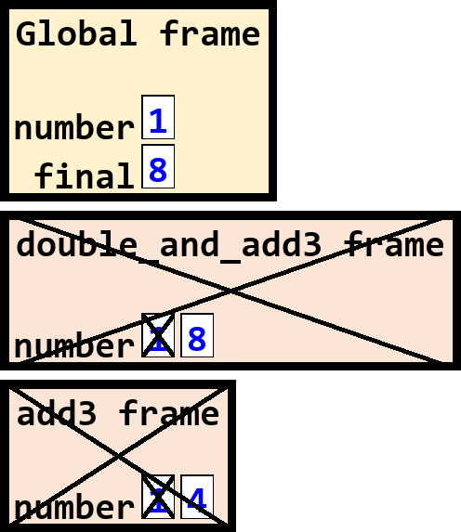
Tracing
def add3(number: int) -> int:
number = number + 3
return number
def double_and_add3(number: int) -> int:
number = 2 * add3(number)
return number
number = 1
final = double_and_add3(number)
Notes:
Explain how we can track the program using boxes (frames) that have labeled boxes inside to represent the variables and values. We cross out values when they change, and cross out boxes when their function ends.

Slide 12
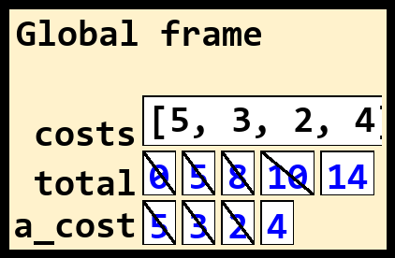
Tracing (loop)
costs = [5, 3, 2, 4]
total = 0
for a_cost in costs:
total += a_cost
print(total)

Slide 13

Tricky Tracing Worksheet
Going to work in groups of 3
First person to open assignment:
Make a copy of the worksheet
Immediately share it with group mates
Everyone needs to put email in the top area in order to receive credit on Canvas
Only one person submits when done
We will review the answers here in class in about 15 minutes.
Start working!

Slide 14
Reviewing Answers
Open up the question list and review the questions with students. Type up a class answer.

Slide 15
CISC108
Have a great day!
Don’t forget:
See ya!

